Slide 1
Decision Trees
Dr. Mehmet Yasin Ulukuş

Slide 2
Decision Trees
Decision trees can be applied to both regression and classification problems
They involve stratifying or segmenting the predictor space into a number of simple regions
Tree-based methods are simple and useful for interpretation but not competitive with the best supervised learning approaches
We will also introduce ensemble techniques, bagging, random forests, through trees
Each of these approaches involves producing multiple trees then combined to yield a single consensus prediction
Combining a large number of trees can often result in dramatic improvements in prediction accuracy, at the expense of some loss in interpretation

Slide 3
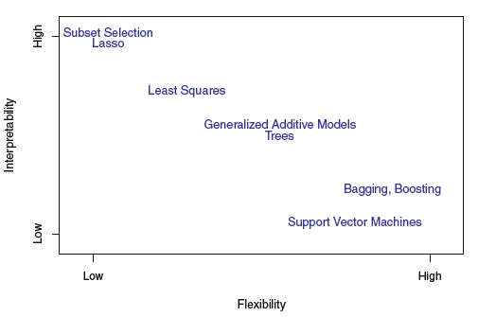
Decision Trees

Slide 4
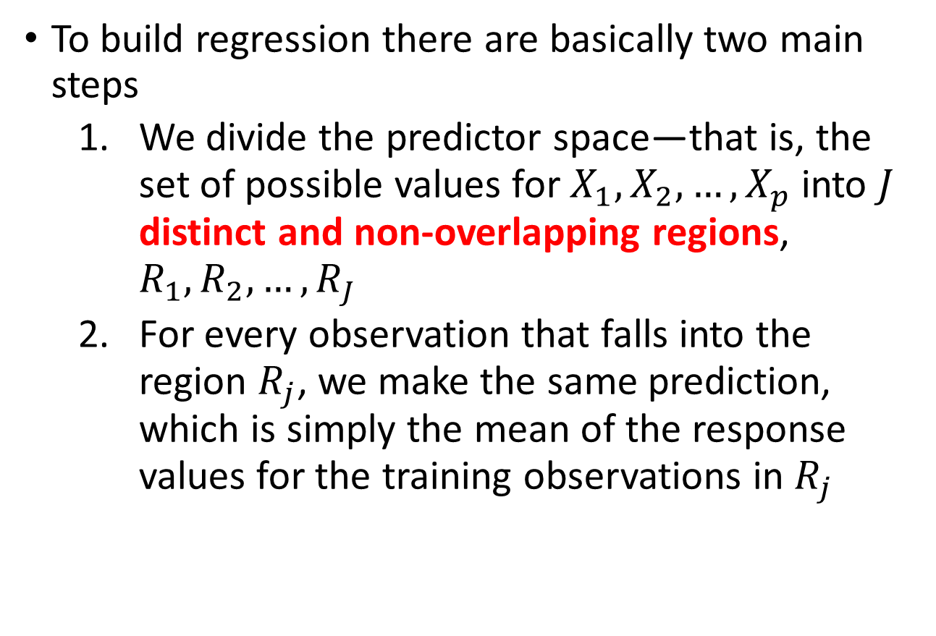
Regression Trees
To build regression there are basically two main steps
We divide the predictor space—that is, the set of possible values for $X_{1},X_{2}, …,X_{p}$into $J$ distinct and non-overlapping regions, $R_{1},R_{2},…,R_{J}$
For every observation that falls into the region $R_{j}$, we make the same prediction, which is simply the mean of the response values for the training observations in $R_{j}$

Slide 5
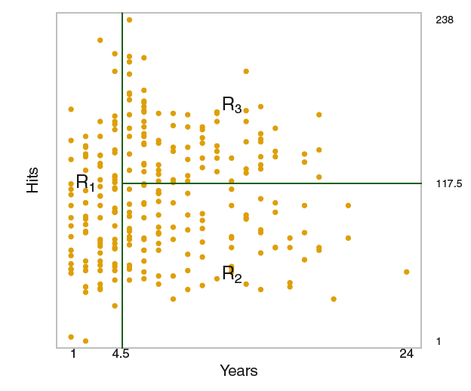
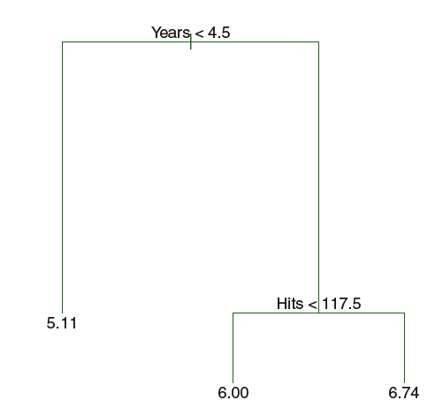



Regression Trees
As an example Hitters data set to predict a baseball player’s log(Salary) based on Years and Hits (the number of hits that he made in the previous year)
Following figures show a regression tree fit to this data
$$\hat{y}={\overline{y}}_{R_{1}}=5.11$$
Use the average of the y values of the observations falling in the region as prediction
$$\hat{y}={\overline{y}}_{R_{3}}=6.74$$
$$\hat{y}={\overline{y}}_{R_{2}}=6.00$$

Slide 6
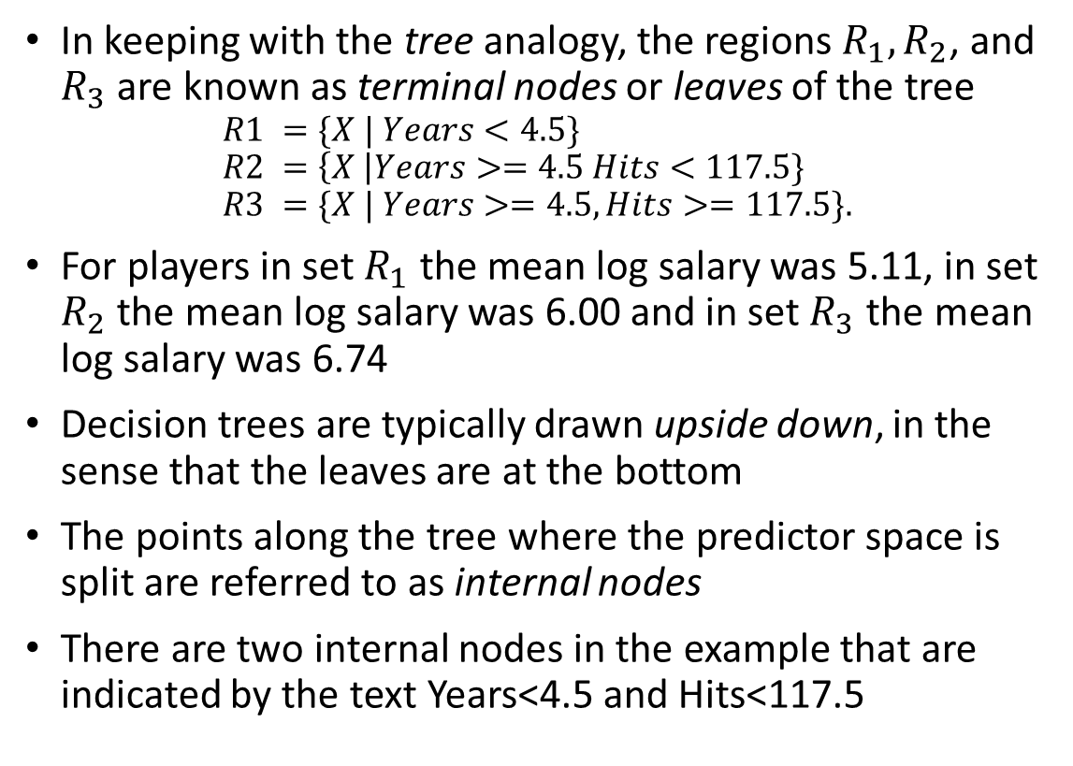
Regression Trees
In keeping with the tree analogy, the regions $R_{1}, R_{2}$, and $R_{3}$ are known as terminal nodes or leaves of the tree
$$R1 =\{X | Years<4.5\} \\ R2 =\left\{X \right|Years>=4.5 Hits<117.5\} \\ R3 =\{X | Years>=4.5, Hits>=117.5\}.$$
For players in set $R_{1}$ the mean log salary was 5.11, in set $R_{2}$ the mean log salary was 6.00 and in set $R_{3}$ the mean log salary was 6.74
Decision trees are typically drawn upside down, in the sense that the leaves are at the bottom
The points along the tree where the predictor space is split are referred to as internal nodes
There are two internal nodes in the example that are indicated by the text Years<4.5 and Hits<117.5

Slide 7
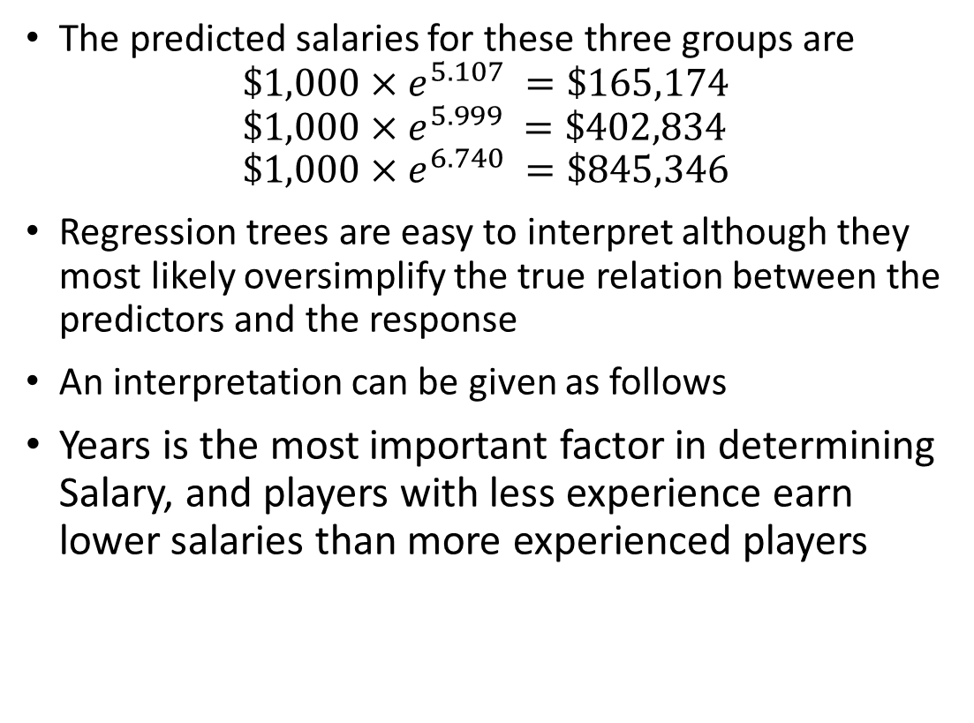
Regression Trees
The predicted salaries for these three groups are
$$\$1,000×e^{5.107} =\$165,174 \\ \$1,000×e^{5.999} =\$402,834 \\ \$1,000×e^{6.740} =\$845,346$$
Regression trees are easy to interpret although they most likely oversimplify the true relation between the predictors and the response
An interpretation can be given as follows
Years is the most important factor in determining Salary, and players with less experience earn lower salaries than more experienced players

Slide 8
Regression Trees
Given that a player is less experienced, the number of hits that he made in the previous year seems to play little role in his salary
Among players who have been in the major leagues for five or more years, the number of hits made in the previous year does affect salary, and players who made more hits last year tend to have higher salaries.

Slide 9
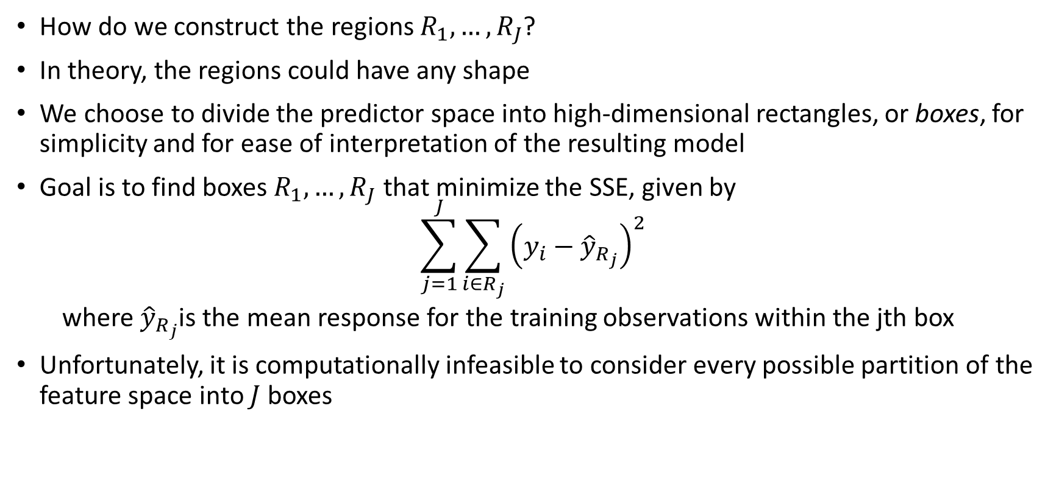
Regression Trees: Constructing Regions
How do we construct the regions $R_{1},…,R_{J}$?
In theory, the regions could have any shape
We choose to divide the predictor space into high-dimensional rectangles, or boxes, for simplicity and for ease of interpretation of the resulting model
Goal is to find boxes $R_{1},…,R_{J}$ that minimize the SSE, given by
$$\sum_{j=1}^{J}{\sum_{i∈R_{j}}{{\left(y_{i}−{\hat{y}}_{R_{j}}\right)}^{2}}}$$
where ${\hat{y}}_{R_{j}}$is the mean response for the training observations within the jth box
Unfortunately, it is computationally infeasible to consider every possible partition of the feature space into $J$ boxes

Slide 10
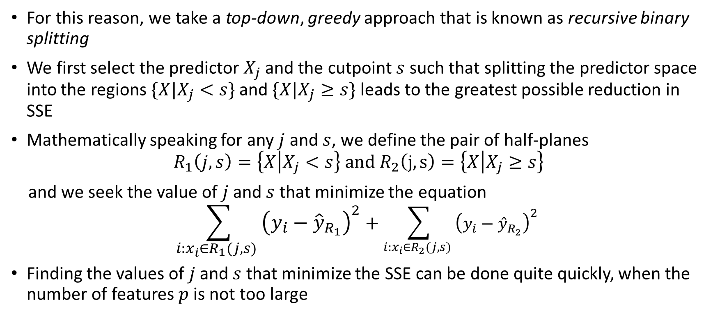
Regression Trees: Constructing Regions
For this reason, we take a top-down, greedy approach that is known as recursive binary splitting
We first select the predictor $X_{j}$ and the cutpoint $s$ such that splitting the predictor space into the regions $\{X|X_{j}<s\}$and $\{X|X_{j}≥s\}$leads to the greatest possible reduction in SSE
Mathematically speaking for any $j$ and $s$, we define the pair of half-planes
$$R_{1}\left(j,s\right)=\left\{X | X_{j}<s\right\} and R_{2}\left(j,s\right)=\left\{X | X_{j}≥s\right\}$$
and we seek the value of $j$ and $s$ that minimize the equation
$$\sum_{i:x_{i}∈R_{1}(j,s) }{{\left(y_{i}−{\hat{y}}_{R_{1}}\right)}^{2}}+\sum_{i:x_{i}∈R_{2}(j,s) }{{\left(y_{i}−{\hat{y}}_{R_{2}}\right)}^{2} }$$
Finding the values of $j$ and $s$ that minimize the SSE can be done quite quickly, when the number of features $p$ is not too large

Slide 11
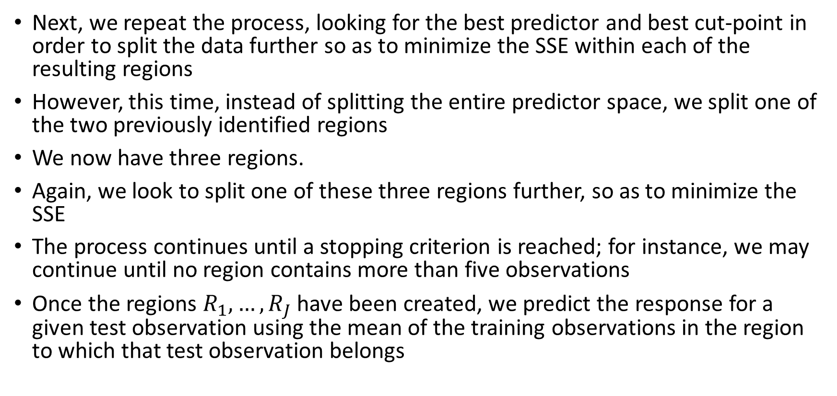
Regression Trees: Constructing Regions
Next, we repeat the process, looking for the best predictor and best cut-point in order to split the data further so as to minimize the SSE within each of the resulting regions
However, this time, instead of splitting the entire predictor space, we split one of the two previously identified regions
We now have three regions.
Again, we look to split one of these three regions further, so as to minimize the SSE
The process continues until a stopping criterion is reached; for instance, we may continue until no region contains more than five observations
Once the regions $R_{1},…,R_{J}$ have been created, we predict the response for a given test observation using the mean of the training observations in the region to which that test observation belongs

Slide 12
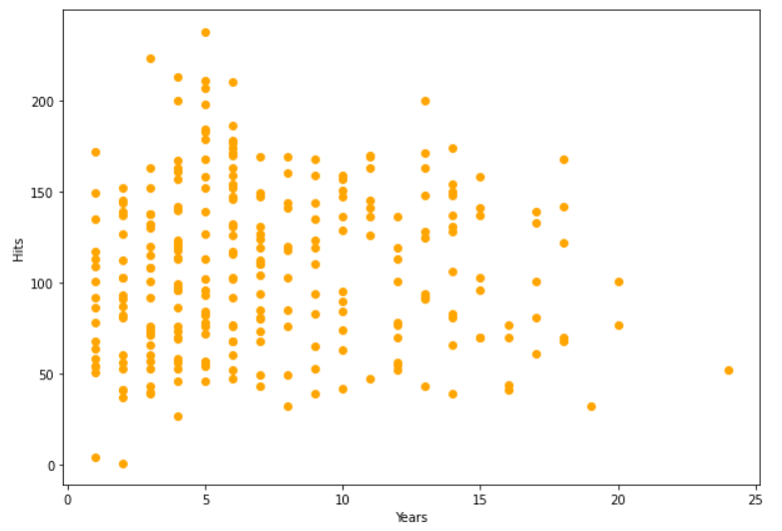
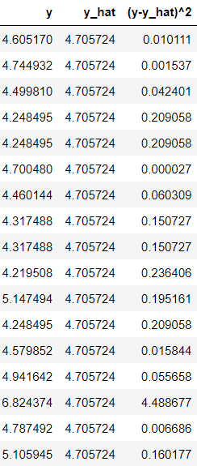

Regression Trees: Constructing Regions
Compute SSE
For all possible
splits
$$SSE_{R_{1}}=6.201623$$

Slide 13
Regression Trees: Constructing Regions
Years<4.5
Pick the split
with the best SSE

Slide 14
Regression Trees: Constructing Regions
Years<4.5
Repeat the same
procedure
for each region

Slide 15
Regression Trees: Constructing Regions
Years<4.5
Again pick the
best split (the one with the minimum SSE)
Keep repeating the same procedure for each region
Hits<117.5

Slide 16
Regression Trees: Constructing Regions
Years<4.5
Pick the best one
Keep repeating the same procedure for each region until a stopping condition met
Hits<117.5
Years<12

Slide 17
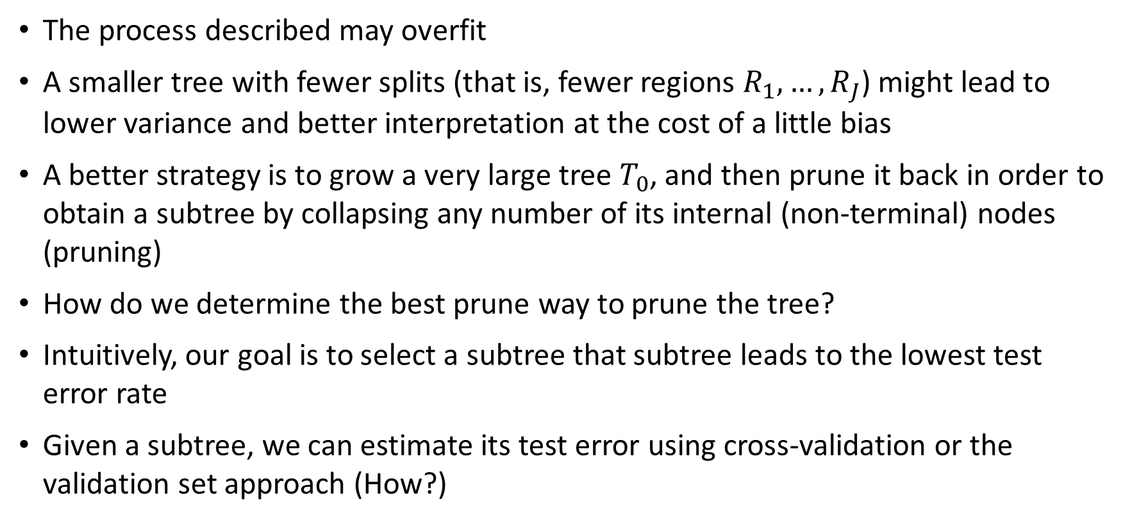
Regression Trees: Pruning
The process described may overfit
A smaller tree with fewer splits (that is, fewer regions $R_{1},…,R_{J}$) might lead to lower variance and better interpretation at the cost of a little bias
A better strategy is to grow a very large tree $T_{0}$, and then prune it back in order to obtain a subtree by collapsing any number of its internal (non-terminal) nodes (pruning)
How do we determine the best prune way to prune the tree?
Intuitively, our goal is to select a subtree that subtree leads to the lowest test error rate
Given a subtree, we can estimate its test error using cross-validation or the validation set approach (How?)

Slide 18
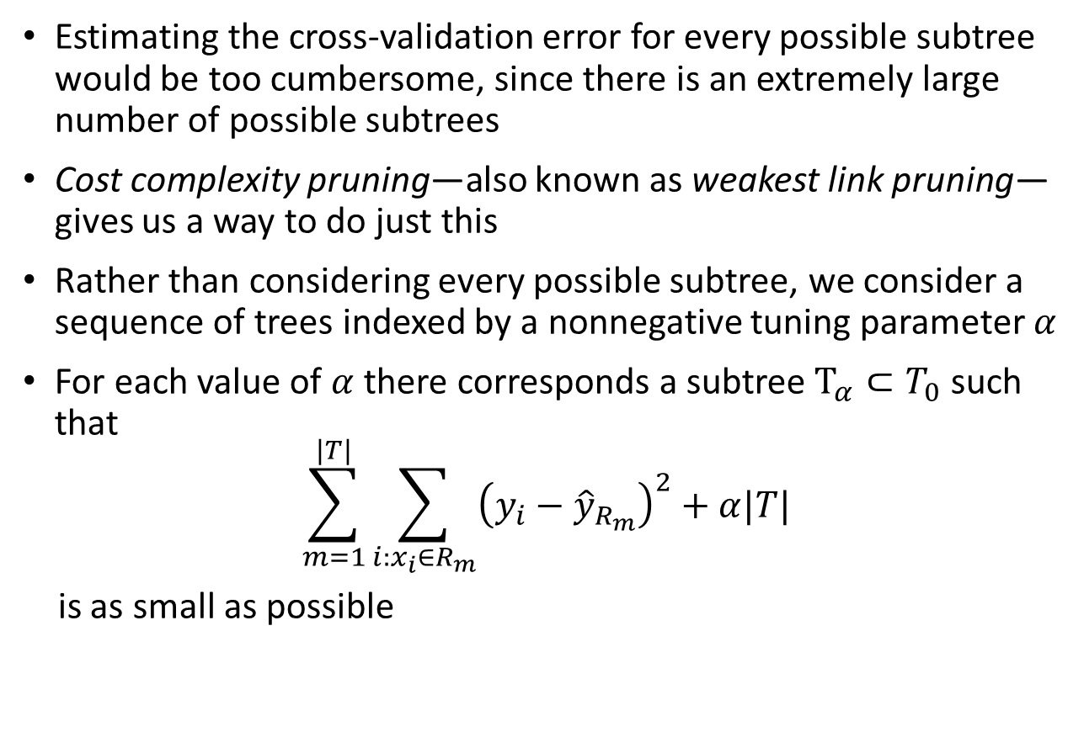
Regression Trees: Pruning
Estimating the cross-validation error for every possible subtree would be too cumbersome, since there is an extremely large number of possible subtrees
Cost complexity pruning—also known as weakest link pruning—gives us a way to do just this
Rather than considering every possible subtree, we consider a sequence of trees indexed by a nonnegative tuning parameter $α$
For each value of $α$ there corresponds a subtree $T_{α}⊂T_{0}$ such that
$$\sum_{m=1}^{|T|}{\sum_{i:x_{i}∈R_{m}}{{\left(y_{i}−{\hat{y}}_{R_{m}}\right)}^{2}}+α|T|}$$
is as small as possible
# of terminal nodes in the subtree

Slide 19
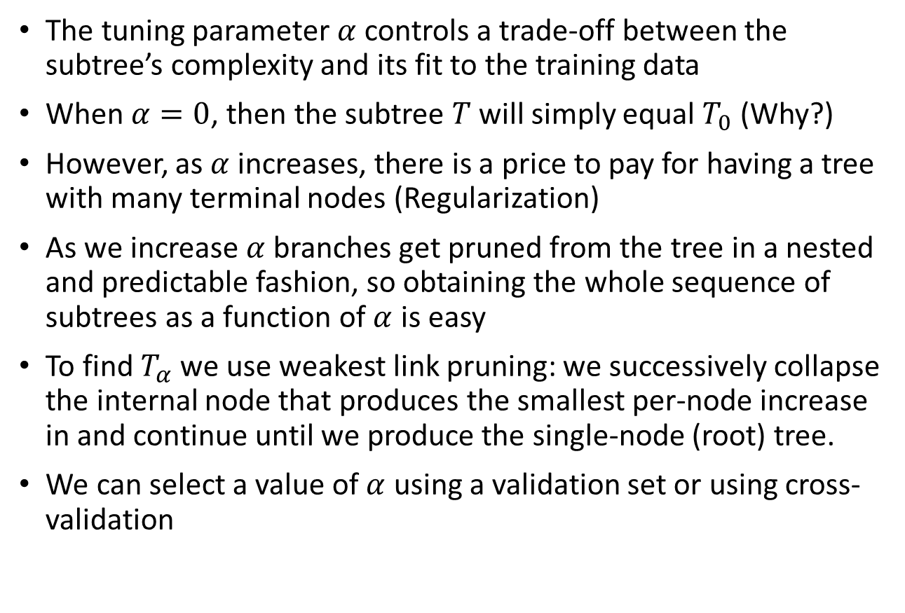
Regression Trees: Pruning
The tuning parameter $α$ controls a trade-off between the subtree’s complexity and its fit to the training data
When $α=0$, then the subtree $T$ will simply equal $T_{0}$ (Why?)
However, as $α$ increases, there is a price to pay for having a tree with many terminal nodes (Regularization)
As we increase $α$branches get pruned from the tree in a nested and predictable fashion, so obtaining the whole sequence of subtrees as a function of $α$ is easy
To find $T_{α}$ we use weakest link pruning: we successively collapse the internal node that produces the smallest per-node increase in and continue until we produce the single-node (root) tree.
We can select a value of $α$ using a validation set or using cross-validation

Slide 20
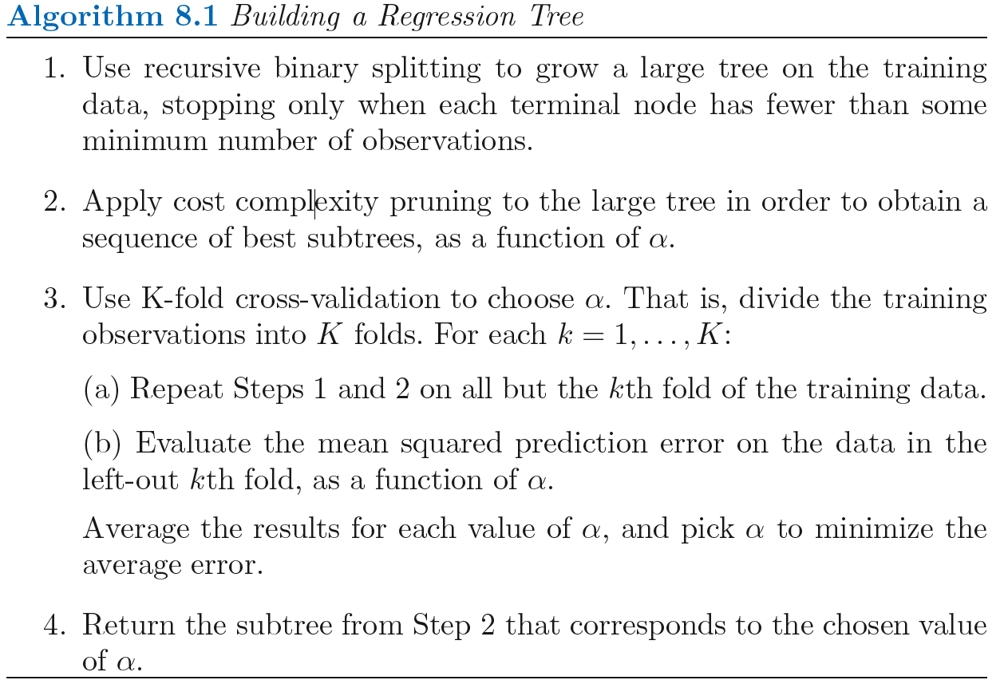
Building Regression Tree

Slide 21
Classification Trees
A classification tree is very similar to a regression tree
Recall that for a regression tree, the predicted response for an observation is given by the mean response
In contrast, for a classification tree, we predict that each observation belongs to the most commonly occurring class of training observations in the region to which it belongs
The task of growing a classification tree is quite similar to the task of growing a regression tree
Just as in the regression setting, we use recursive binary splitting to grow a classification tree
However, in the classification setting, SSE cannot be used as a criterion for making the binary splits

Slide 22

Classification Trees
A natural alternative to SSE is the classification error rate
The classification error rate is simply the fraction of the training observations in that region that do not belong to the most common class
$$E=1−\max_{k}{{\hat{p}}_{mk}}$$
Here ${\hat{p}}_{mk}$represents the proportion of training observations in the mth region that are from the kth class
1
X2<0.5
X2
X1<0.6
0
X1
1

Slide 23
Classification Trees
A natural alternative to SSE is the classification error rate
The classification error rate is simply the fraction of the training observations in that region that do not belong to the most common class
$$E=1−\max_{k}{{\hat{p}}_{mk}}$$
Here ${\hat{p}}_{mk}$represents the proportion of training observations in the mth region that are from the kth class
1
X2<0.5
X2
0
X1
1

Slide 24
Classification Trees
A natural alternative to SSE is the classification error rate
The classification error rate is simply the fraction of the training observations in that region that do not belong to the most common class
$$E=1−\max_{k}{{\hat{p}}_{mk}}$$
Here ${\hat{p}}_{mk}$represents the proportion of training observations in the mth region that are from the kth class
1
X2<0.5
X2
X1<0.6
0
X1
1

Slide 25
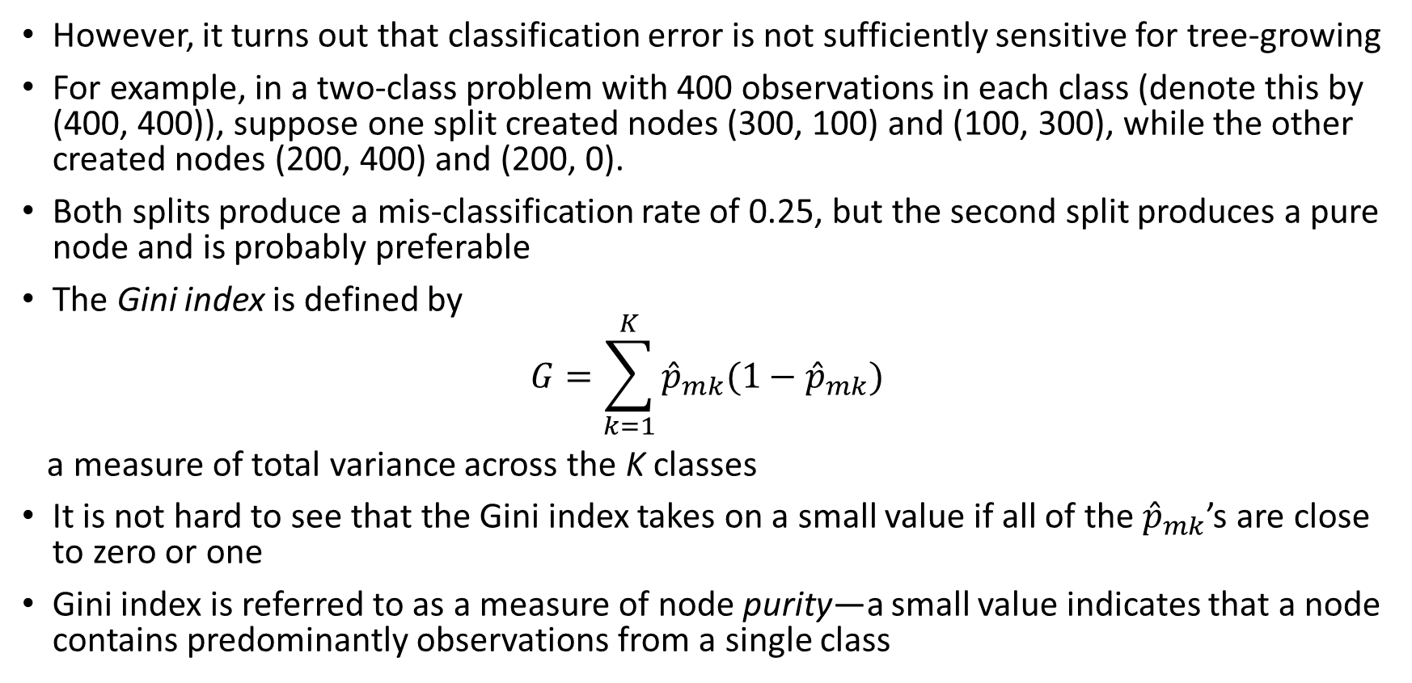
Classification Trees
However, it turns out that classification error is not sufficiently sensitive for tree-growing
For example, in a two-class problem with 400 observations in each class (denote this by (400, 400)), suppose one split created nodes (300, 100) and (100, 300), while the other created nodes (200, 400) and (200, 0).
Both splits produce a mis-classification rate of 0.25, but the second split produces a pure node and is probably preferable
The Gini index is defined by
$$G=\sum_{k=1}^{K}{{\hat{p}}_{mk}(1−{\hat{p}}_{mk})}$$
a measure of total variance across the K classes
It is not hard to see that the Gini index takes on a small value if all of the ${\hat{p}}_{mk}$’s are close to zero or one
Gini index is referred to as a measure of node purity—a small value indicates that a node contains predominantly observations from a single class

Slide 26
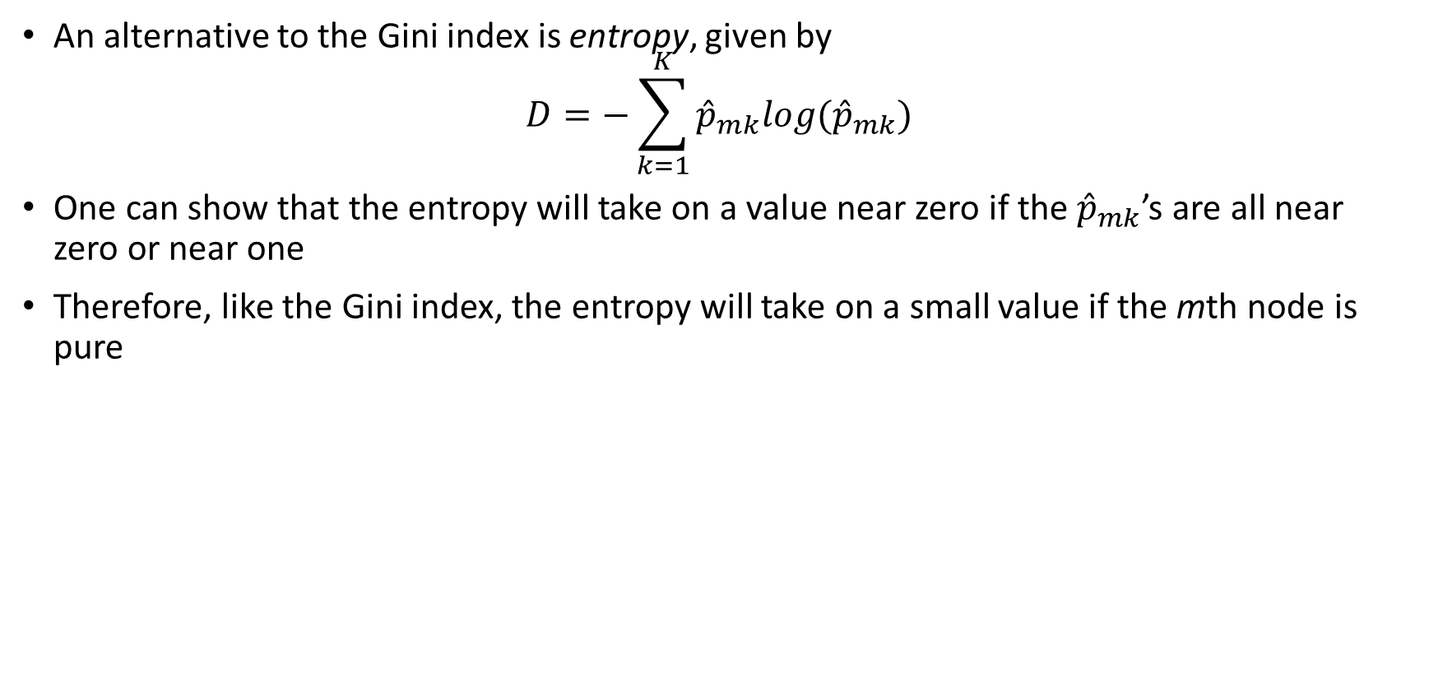
Classification Trees
An alternative to the Gini index is entropy, given by
$$D=−\sum_{k=1}^{K}{{\hat{p}}_{mk}log({\hat{p}}_{mk})}$$
One can show that the entropy will take on a value near zero if the ${\hat{p}}_{mk}$’s are all near zero or near one
Therefore, like the Gini index, the entropy will take on a small value if the mth node is pure

Slide 27
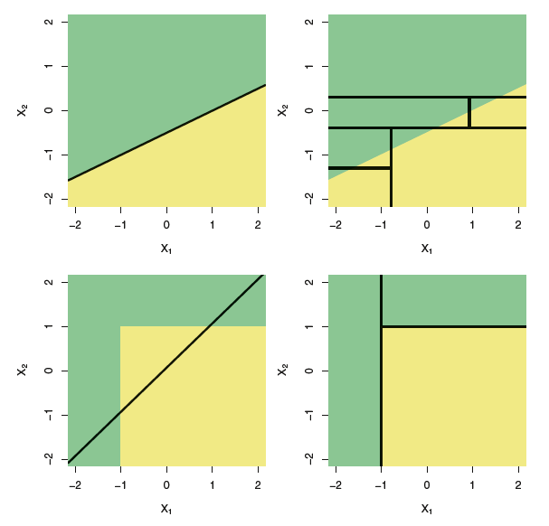
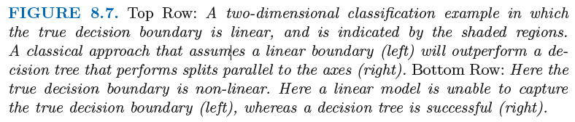
Linear Models vs Tree Models
If the relationship between the features and the response is well approximated by a linear model then an approach such as linear regression will likely work well
If instead there is a highly non-linear and complex relationship between the features and the response then decision trees may outperform classical approaches
The relative performances of tree-based and classical approaches can be assessed by estimating the cross validation error

Slide 28
Advantages and Disadvantages of Trees
Trees are very easy to explain to people. In fact, they are even easier to explain than linear regression!
Some people believe that decision trees more closely mirror human decision-making than do the regression and classification approaches
Trees can be displayed graphically, and are easily interpreted even by a non-expert (especially if they are small)
Trees can easily handle qualitative predictors without the need to create dummy variables (not true for sklearn, but there are some libraries that can handle this (catboost))
Unfortunately, trees generally do not have the same level of predictive accuracy as some of the other regression and classification approaches
Additionally, trees can be very non-robust. In other words, a small change in the data can cause a large change in the final estimated tree

